Slide 1
C# & .NET Framework
Chapter 14:
Building Multithreaded Applications

Slide 2
Review
The Role of .NET Assemblies: code re-use, self-describing, versioning, configurable
Format of an assembly: Win32 header, CLR header, CIL, metadata, manifest, optional resources
Single file vs multi file assemblies
Private vs share assemble
Global Assemby Cache

Slide 3
Chapter 14: Objectives
The Process/AppDomain/Context/Thread Relationship
A Brief Review of the .NET Delegate
The Asynchronous Nature of Delegates.
Invoking a Method Asynchronously
Programmatically Creating Secondary Threads
The Issue of Concurrency
Programming with Timer Callbacks.
Understanding the CLR ThreadPool

Slide 4
Processes and Multi Processing System
A process has a self-contained execution environment. A process generally has a complete, private set of basic run-time resources; in particular, each process has its own memory space.
Multi Processing/ Multi Tasking System: System allows many processes executing concurrently.

Slide 5
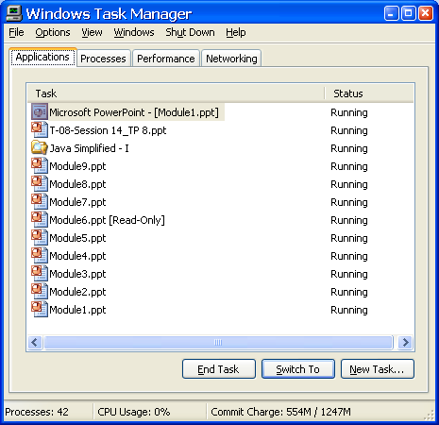
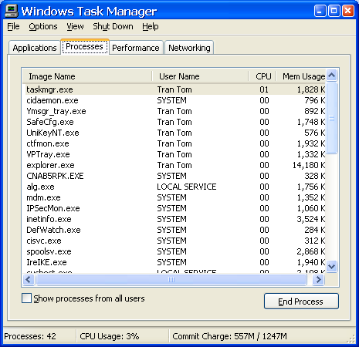
Processes and Multi Processing System

Slide 6
How can OS manage concurrent processes
App | Code Addr | Duration (mili sec) | CPU
App1 | 10320 | 15 | 1
App2 | 40154 | 17 | 2
App3 | 80166 | 22 | 1
… | … | … | …
… | … | … | …
App1
Code
Data
App2
Code
Data
App3
Code
Data
Time-slicing
Mechanism
Memory
A method of allocating CPU time to individual process in a priority schedule.

Slide 7
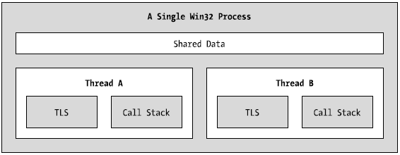
Process/AppDomain/Context/Thread
A thread is a path of execution within an executable application.
By implementing additional threads, you can build more responsive (but not necessarily faster executing) applications.
Under the .NET platform, there is not a direct one-to-one correspondence between application domains and threads.
The Win32 process/thread relationship

Slide 8
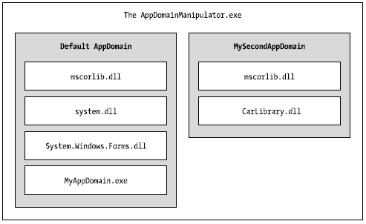
Process/AppDomain/Context/Thread
Under the .NET platform, assemblies are not hosted directly within a process. Rather, a .NET executable is hosted by a logical partition within a process termed an application domain
A single process may contain multiple application domains, each of which is hosting a .NET executable.
AppDomains is fully and completely isolated from each other within same process.

Slide 9
Process/AppDomain/Context/Thread
A given AppDomain can have numerous threads executing within it at any given time.
Threads are free to cross application domain boundaries as the Win32 thread scheduler and CLR see fit.
A given thread can execute within only a single application domain at any point in time
A single thread may also be moved into a particular context at any given time, and it may be relocated within a new context at the whim of the CLR.

Slide 10
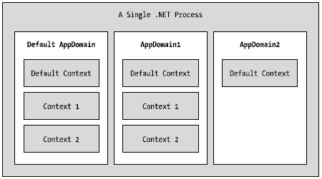
Process/AppDomain/Context/Thread
A given application domain may be further subdivided into numerous context boundaries.
Using context, the CLR is able to ensure that objects that have special runtime requirements are handled in an appropriate and consistent manner by intercepting method invocations into and out of a given context.

Slide 11

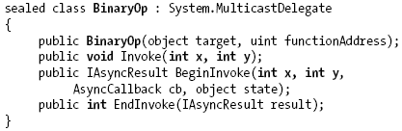
Review of the .NET Delegate

Slide 12
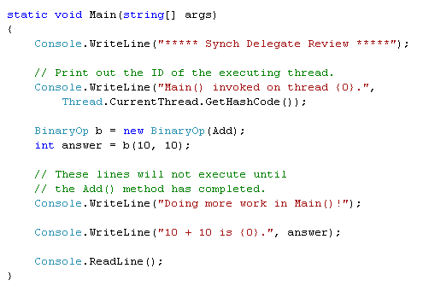
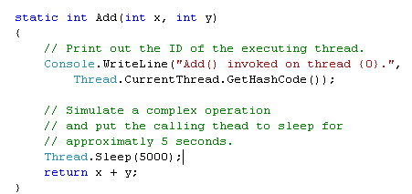
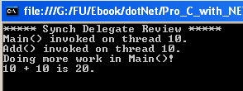
Synchronous Demo
These lines will not execute until the add() method has completed its execution
Example: Ch_14 Code\SyncDelegate

Slide 13
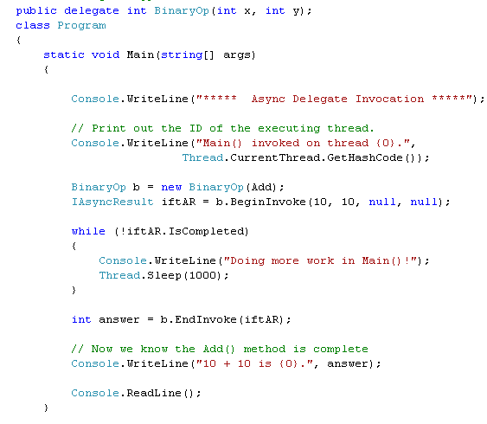
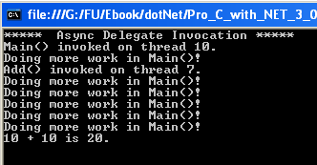
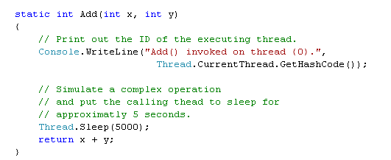
Asynchronous Demo
Example: Ch_14 Code\ AsyncDelegate

Slide 14
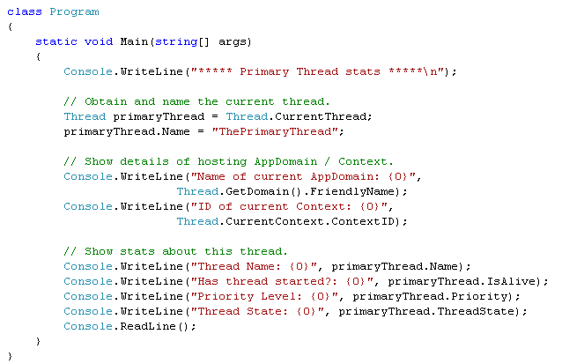
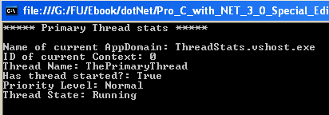
System.Threading.Thread Demo
Example: Ch_14 Code\ ThreadStats

Slide 15
Steps to create a Thread
Create a type method to be the entry point for the new thread.
Create a new ParameterizedThreadStart (or legacy ThreadStart) delegate, passing the address of the method defined in step 1 to the constructor.
Create a Thread object, passing the ParameterizedThreadStart/ThreadStart delegate as a constructor argument.
Establish any initial thread characteristics (name, priority, etc.).
Call the Thread.Start() method. This starts the thread at the method referenced by the delegate created in step 2 as soon as possible.

Slide 16
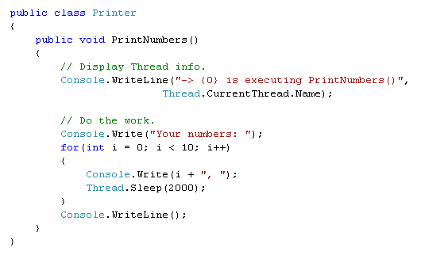
Thread Demo 1
1

Slide 17
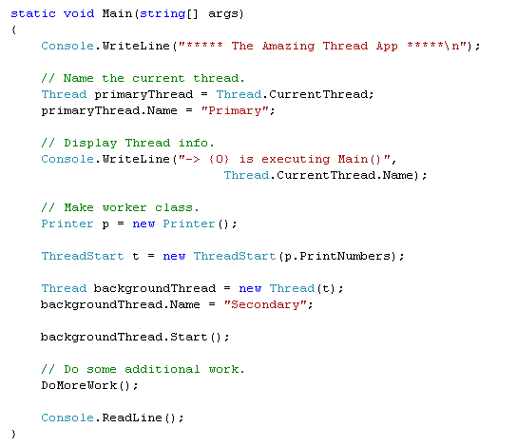
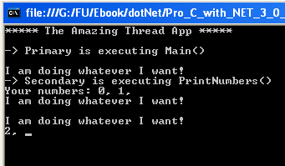
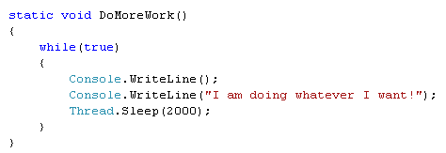
2
3,4
5
Example: Ch_14 Code\ SimpleMultiThreadApp

Slide 18
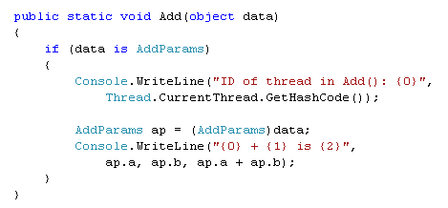
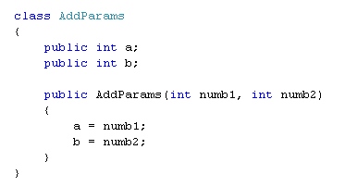
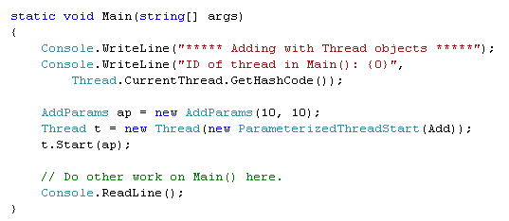
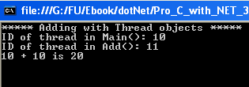
Thread Demo 2
Example: Ch_14 Code\ AddWithThreads

Slide 19
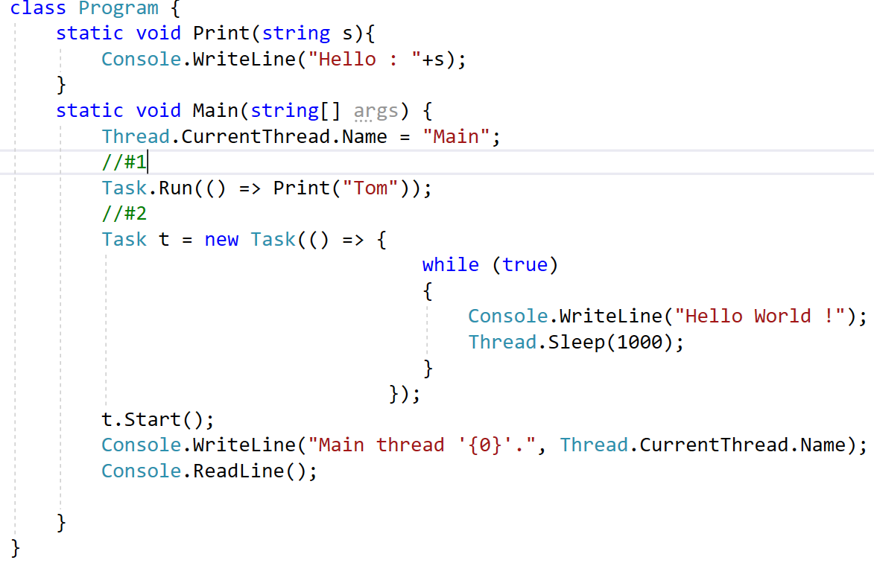
Demo Task

Slide 20
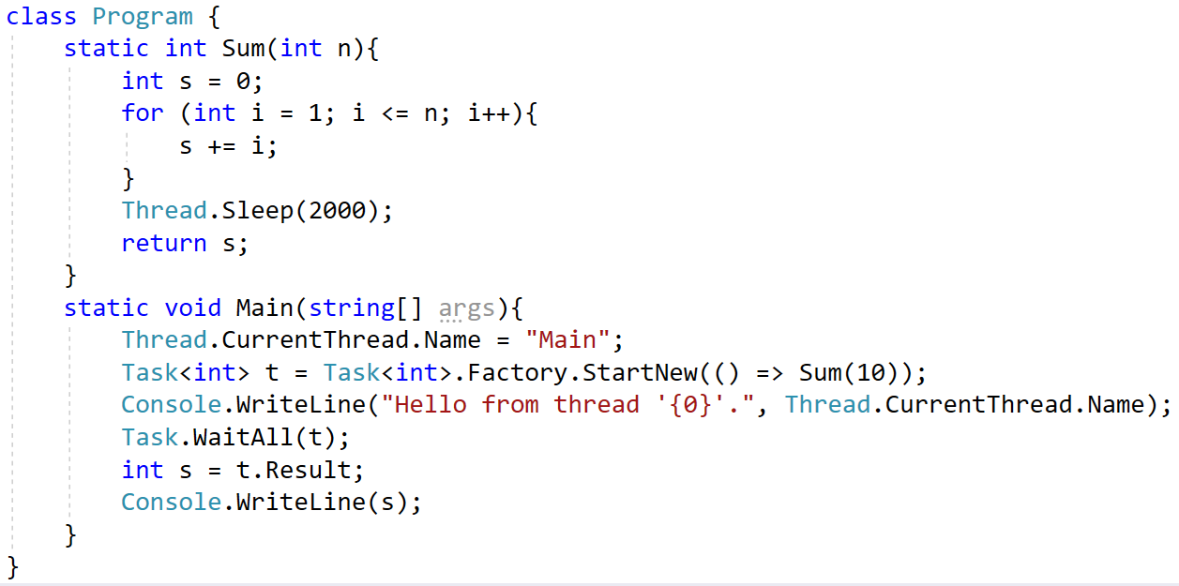
Demo Task

Slide 21
Foreground Threads and Background Threads
Foreground threads have the ability to prevent the current application from terminating. TheCLR will not shut down an application (which is to say, unload the hosting AppDomain) until all foreground threads have ended.
Background threads (sometimes called daemon threads) are viewed by the CLR as expendable paths of execution that can be ignored at any point in time (even if they are currently laboring over some unit of work).
Thus, if all foreground threads have terminated, any and all background threads are automatically killed when the application domain unloads.
Example: BackgroundThread

Slide 22
The Issue of Concurrency: Race Conditions
Application
Data 1 (shared data)
Data 2
Data 3
Thread 1
Thread 2
Thread3
Thread 4
A race
occured
Need
Synchronization

Slide 23
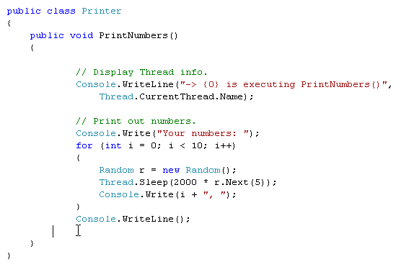
Race condition demo
No synchronized technique

Slide 24
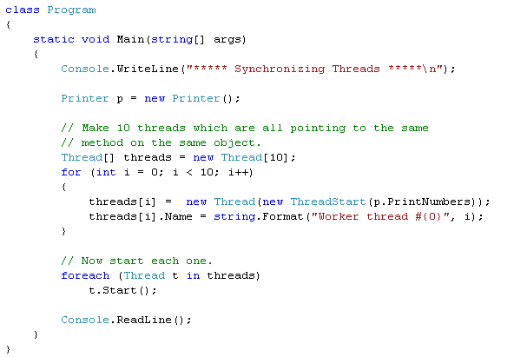
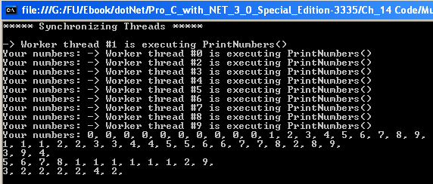
Unpredictable results

Slide 25
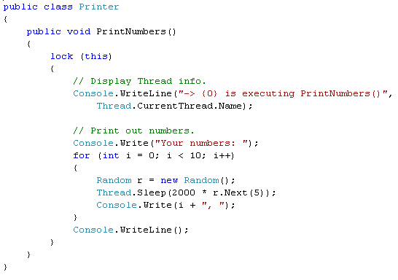
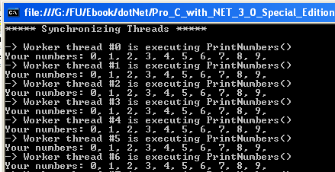
Synchronized technique: using lock()
OK
Example: Ch_14 Code\ MultiThreadedPrinting

Slide 26
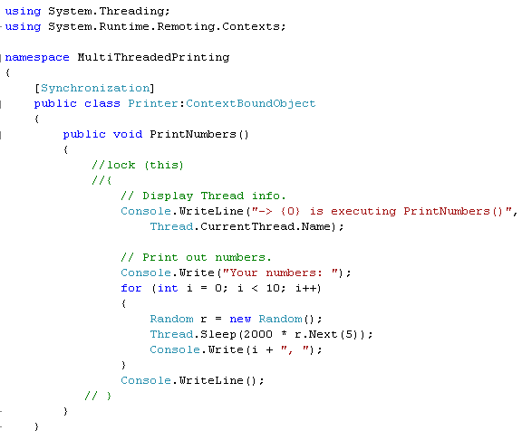
Synchronized technique: using [Synchronization] attribute
So, what to use, lock() or
[Synchronization] ???
Example: Ch_14 Code\ MultiThreadedPrinting

Slide 27
Timer Callbacks
Many applications have the need to call a specific method during regular intervals of time:
display the current time on a status bar via a given helper function.
perform noncritical background tasks such as checking for new e-mail messages.
Use the System.Threading.Timer type in conjunction with a related delegate named TimerCallback.

Slide 28
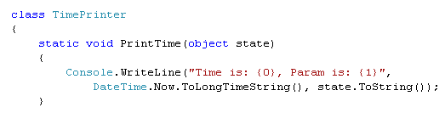
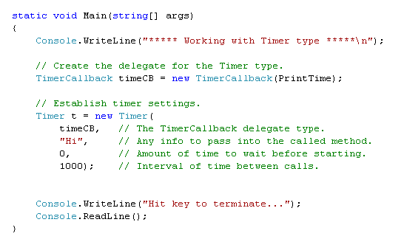
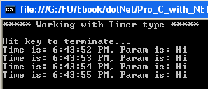
Timer Callback Demo
Example: Ch_14 Code\ TimerApp

Slide 29
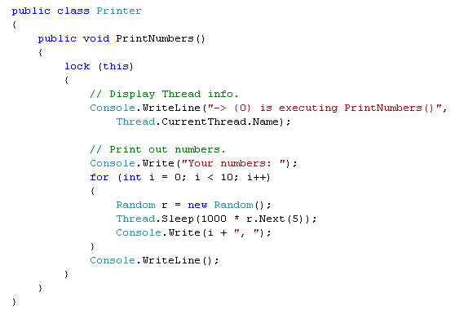
CLR ThreadPool
The System.Threading namespace provides the ThreadPool class type to interact with this pool of waiting threads

Slide 30
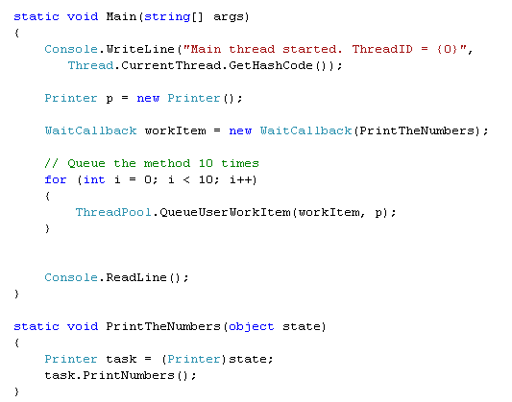
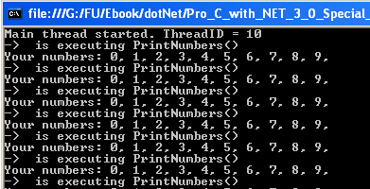
Thread Pool Demo
Example: Ch_14 Code\ ThreadPoolApp

Slide 31
CLR ThreadPool
Thread pool:
The thread pool manages threads efficiently by minimizing the number of threads that must be created, started, and stopped.
By using the thread pool, you can focus on your business problem rather than the application’s threading infrastructure.
Manual thread management:
Pooled threads are always background threads with default priority (ThreadPriority.Normal).
If you require a thread with a fixed identity in order to abort it, suspend it, or discover it by name.

Slide 32
Chapter 14: Summary
Process, Application Domain, Context, Thread
Issue of concurrency: race condition
Synchronized technique: lock(), [synchronization] attribute
TimerCallBack
ThreadPool

Slide 33
Chapter 14: Q & A

